Slide 1
Instructing Language Models to Do Reasoning Wisely
Meng Jiang
Department of Computer Science and Engineering
University of Notre Dame

Slide 2
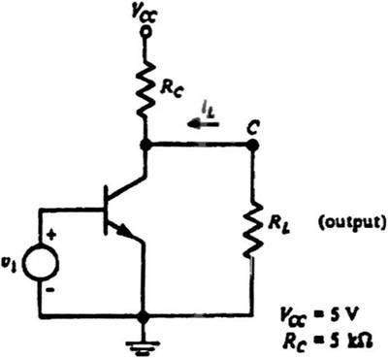
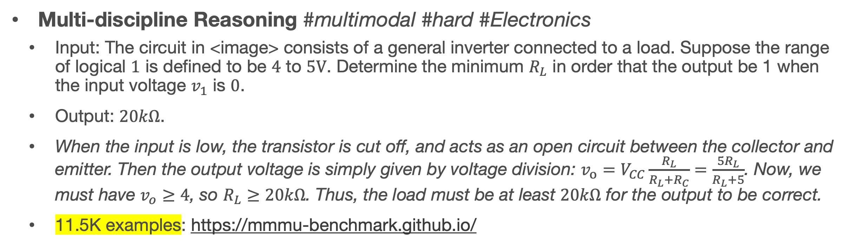
Reasoning in Natural Language
Can we build machines (i.e., language models) to do these tasks?
Math Reasoning
Input: Roger has 5 tennis balls. He buys 2 more cans of tennis balls. Each can has 3 tennis balls. How many tennis balls does he have now?
Output: The answer is 11.
37K examples: https://math-qa.github.io/math-QA/ and many other datasets
Multi-discipline Reasoning #multimodal #hard #Electronics
Input: The circuit in <image> consists of a general inverter connected to a load. Suppose the range of logical $1$ is defined to be $4$ to $5V$. Determine the minimum $R_{L}$ in order that the output be 1 when the input voltage $v_{1}$ is $0$.
Output: $20kΩ$.
When the input is low, the transistor is cut off, and acts as an open circuit between the collector and emitter. Then the output voltage is simply given by voltage division: $v_{o}=V_{CC}\frac{R_{L}}{R_{L}+R_{C}}=\frac{5R_{L}}{R_{L}+5}$. Now, we must have $v_{o}≥4$, so $R_{L}≥20kΩ$. Thus, the load must be at least $20kΩ$ for the output to be correct.
11.5K examples: https://mmmu-benchmark.github.io/

Slide 3
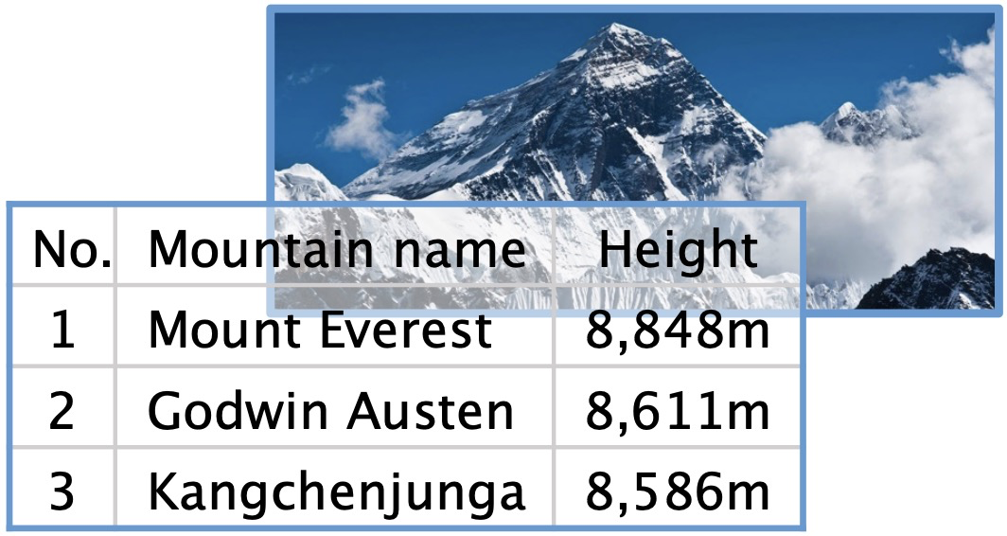
Reasoning in Natural Language (cont.)
Can we build machines (i.e., language models) to do the tasks?
Counterfactual Presupposition
Input: If the movement of the earth’s crust caused the height of Mount Everest to drop by 300 meters, what would be the highest mountain in the world?
Output: K2 (Godwin Austen)
3.8K examples: https://github.com/wyu97/IfQA
Commonsense Reasoning & Abductive Reasoning
More examples and datasets

Slide 4
Multi-choice Commonsense Question Answering
Commonsense Fact Verification
Where can I stand on a river to see water falling without getting wet?
A pound of cotton has the same weight as a pound of steel.
A) waterfall
B) bridge
C) valley
D) stream
E) bottom
True
False
Datasets:
OpenBookQA: Clark et al. arxiv 2018. (5,957 questions)
CommonsenseQA 1.0： Talmor et al. NAACL 2019. (12,102)
Evaluation: Accuracy.
Datasets:
CommonsenseQA 2.0: Talmor et al. (14,343 assertions)
CREAK： Onoe et al. NeurIPS 2021 Benchmark Track. (13,000)
Evaluation: Accuracy.
Constrained Commonsense Generation
Counterfactual Explanation Generation
Constraints: dog, frisbee, catch, throw
I am hungry for water.
Description: A girl throws a frisbee and her dog catches it.
Outputs:
1) Water is used to quench thirsty.
2) You are thirsty for water, not hungry.
3) Water is not food.
Datasets:
CommonGen: Lin et al. Findings of EMNLP 2020. (79,000+ commonsense descriptions)
Evaluation: SPICE, BLEU-4, ROUGE-L, CIDEr.
Datasets:
ComVE: Wang et al. SemEval-2020 Task 4 (11,997 examples)
Evaluation: SPICE, BLEU-4, ROUGE-L, CIDEr.

Slide 5
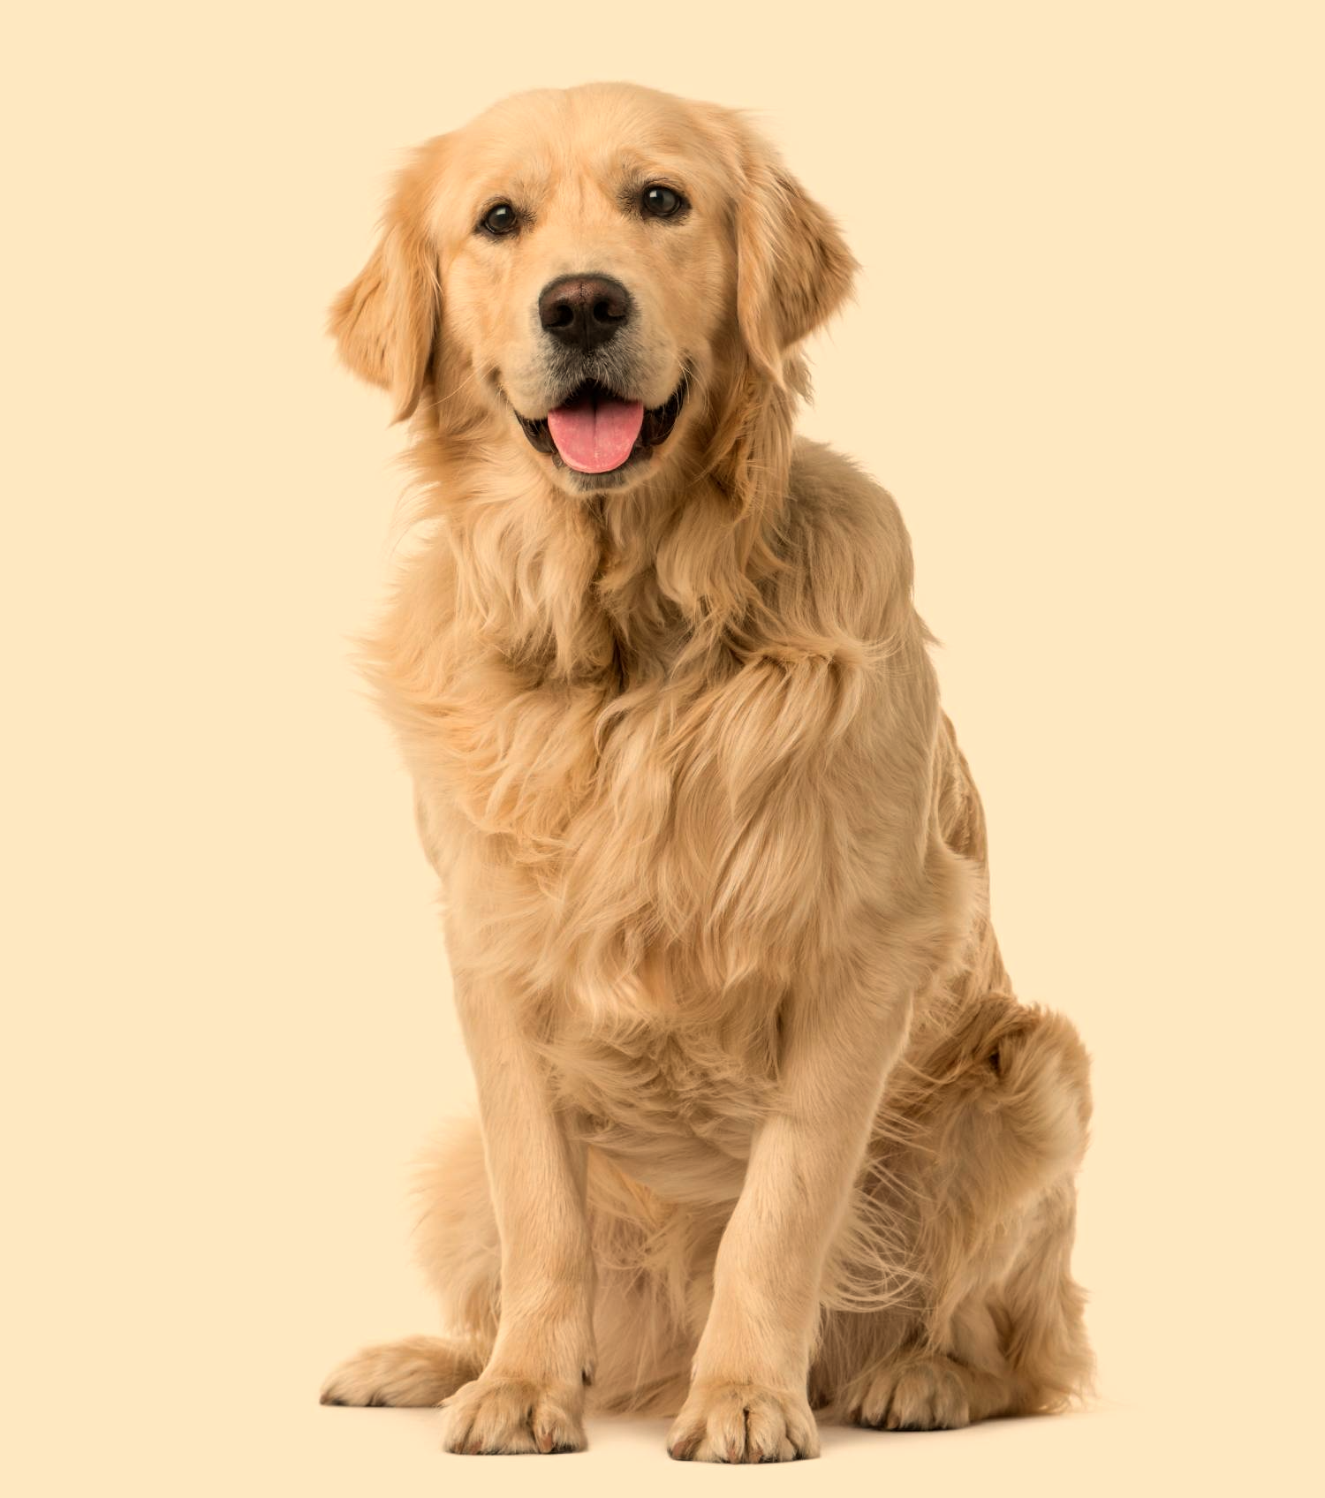
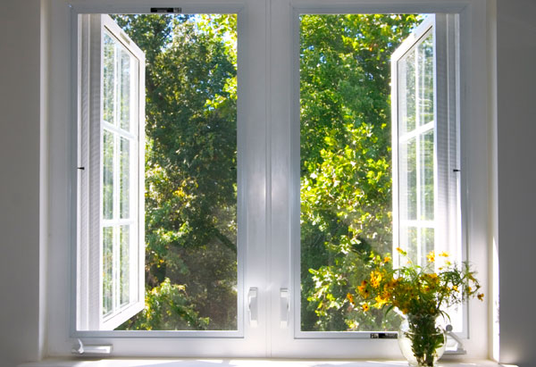
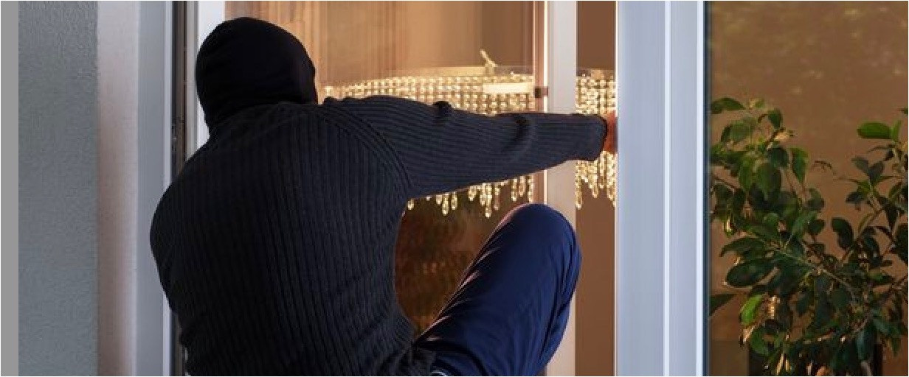
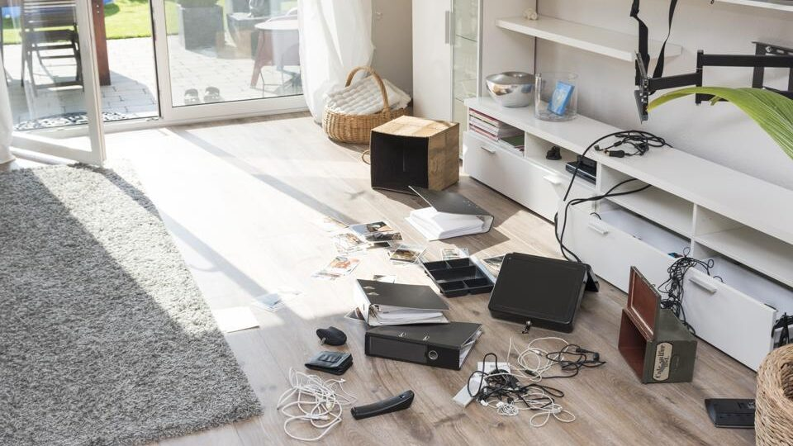
Abductive Reasoning
Cleaned house
Went to work
Leaved windows open
?
All dogs have ears.
Golden retrievers are dogs.
Golden retriever have ears.
Back home
Found a mess
Deductive
Reasoning

Slide 6
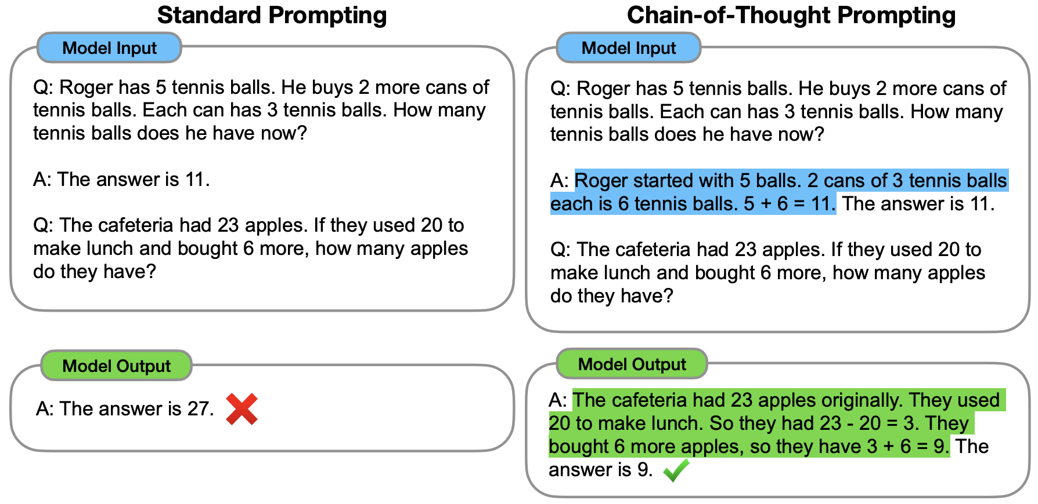
Chain of Thoughts
Known as one of the “Emergent Abilities” of Large Language Models (LLMs)
One-shot in-context learning (ICL): “learn” the Q-A pair without model training.
Past (deep) learning models did not show the few-shot learning abilities in context.
Chain-of-thoughts improves reasoning.
Wei et al. https://arxiv.org/abs/2201.11903

Slide 7
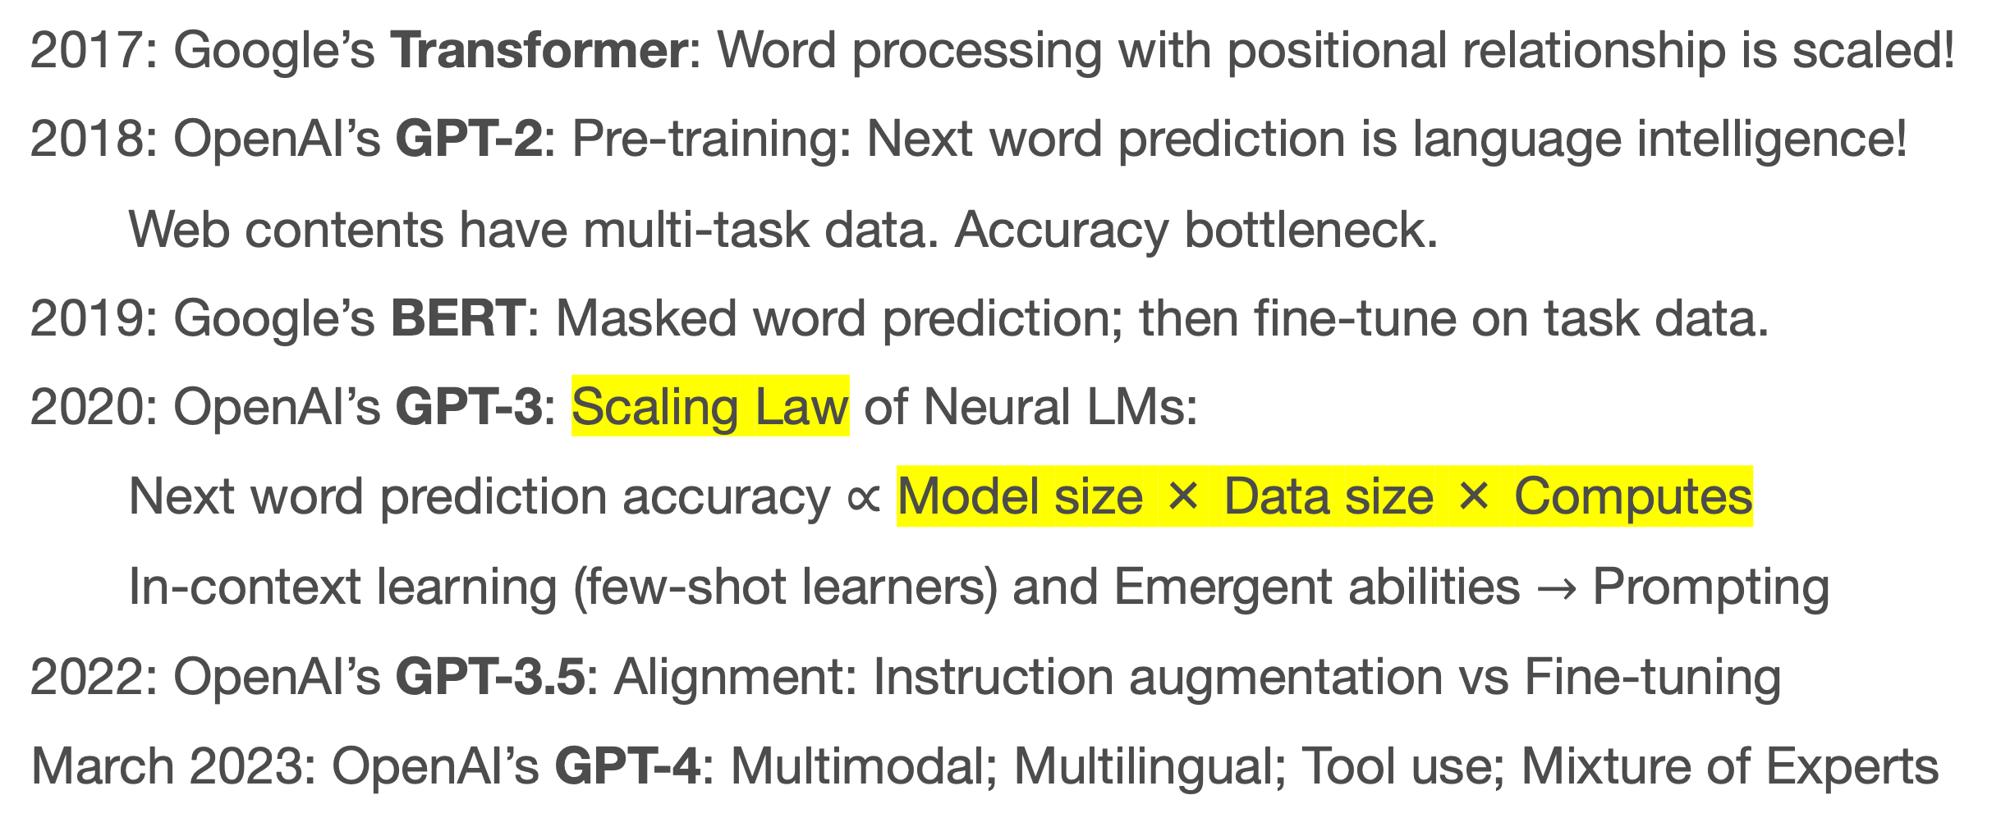
Key Techs Behind LLMs
Transformer, Common Crawl, and Nvidia
2017: Google’s Transformer: Word processing with positional relationship is scaled!
2018: OpenAI’s GPT-2: Pre-training: Next word prediction is language intelligence!
Web contents have multi-task data. Accuracy bottleneck.
2019: Google’s BERT: Masked word prediction; then fine-tune on task data.
2020: OpenAI’s GPT-3: Scaling Law of Neural LMs:
Next word prediction accuracy ∝ Model size × Data size × Computes
In-context learning (few-shot learners) and Emergent abilities $→$ Prompting
2022: OpenAI’s GPT-3.5: Alignment: Instruction augmentation vs Fine-tuning
March 2023: OpenAI’s GPT-4: Multimodal; Multilingual; Tool use; Mixture of Experts

Slide 8
How does human solve (complex) reasoning tasks?
Let’s instruct LLMs to do reasoning wisely
by human-like prompting or instruction tuning.

Slide 9
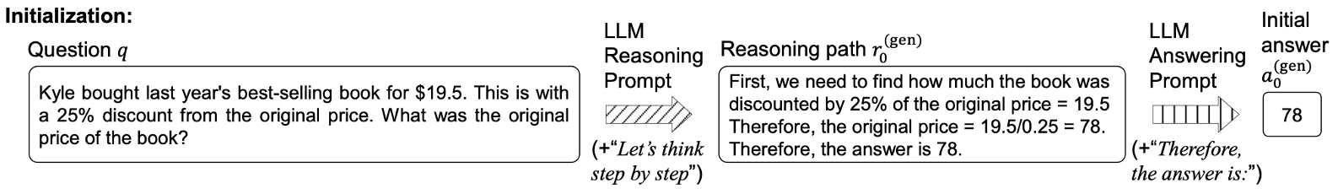
Kyle bought last year’s best-selling book for $19.5. This is with a 25% discount from the original price. What was the original price of the book?
First, we need to find how much the book was discounted by 25% of the original price = 19.5. Therefore, the original price = 19.5/0.25 = 78. Therefore, the answer is 78. ×
19.5 / (1 – 0.25) = 26.
Wu et al. Get an A in Math: Progressive Rectification Prompting (AAAI’24) https://arxiv.org/abs/2312.06867

Slide 10
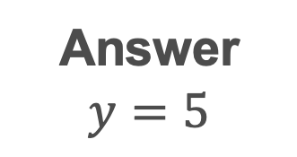
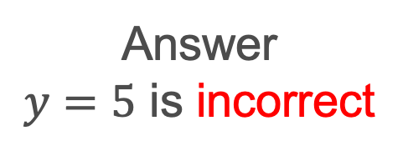
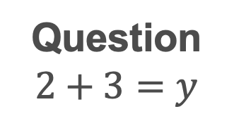
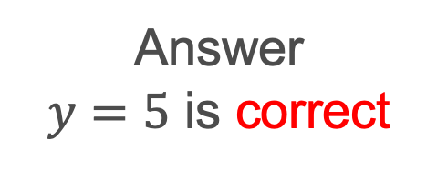
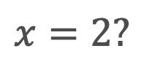
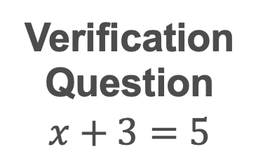
Substitute Verification
Masking key condition
No
Answer
$y=5$ is incorrect
Verification Question
$$x+3=5$$
Question
$$2+3=y$$
Answer
$$y=5$$
$$x=2?$$
Solving
Substitute
Solving
Answer
$y=5$ is correct
Yes

Slide 11
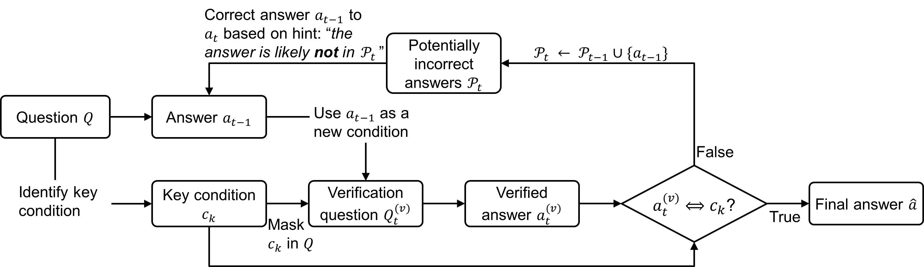
Progressive Correction
Correction Phase
Verification Phase

Slide 12
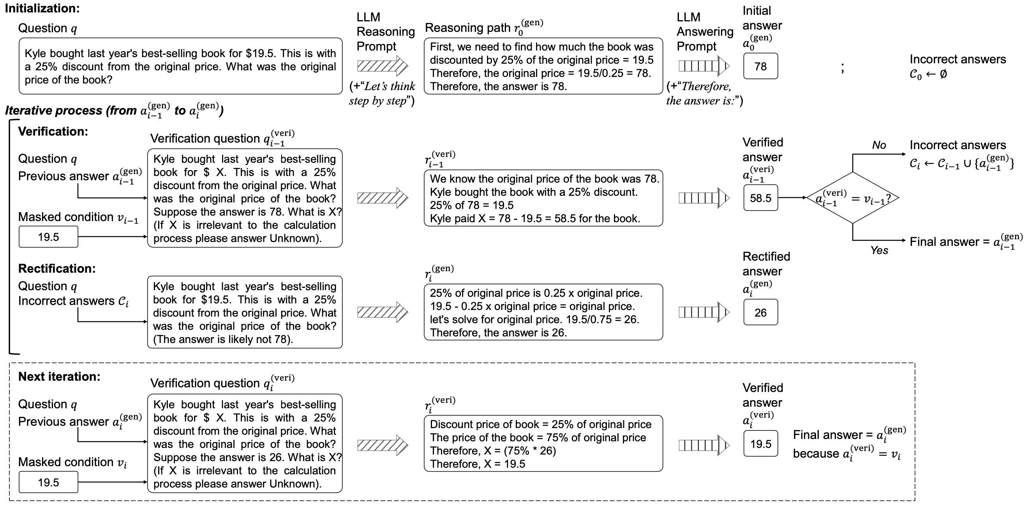
Wu et al. Get an A in Math: Progressive Rectification Prompting (AAAI’24) https://arxiv.org/abs/2312.06867

Slide 13
Results
Method (text-davinci-003) | Dataset |  |  |  |  |  |  |  | Average
 | AddSub | MultiArith | SVAMP | GSM8K | SingleEq | SingleOp | GSM-IC2-1K | GSM-ICM-1K
Direct | 89.3 | 25.8 | 65.2 | 15.0 | 84.6 | 92.1 | 22.8 | 9.0 | 50.5
Zero-Shot-CoT | 84.8 | 87.0 | 74.3 | 60.8 | 89.5 | 89.1 | 70.7 | 62.5 | 77.3
PS | 88.1 | 87.2 | 72.0 | 58.2 | 89.2 | 89.5 | 70.9 | 63.5 | 77.3
PRP (Ours) | 94.7 | 96.3 | 86.2 | 73.6 | 96.5 | 96.1 | 93.1 | 87.1 | 90.5

Slide 14
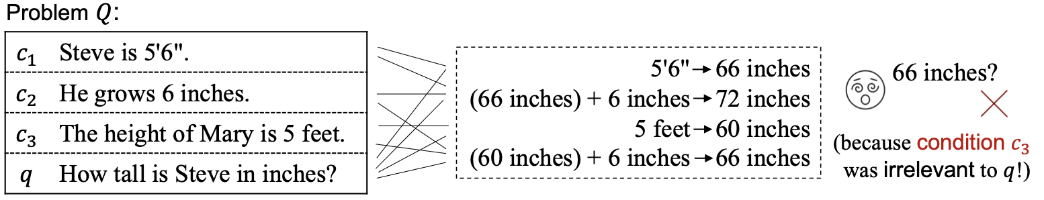
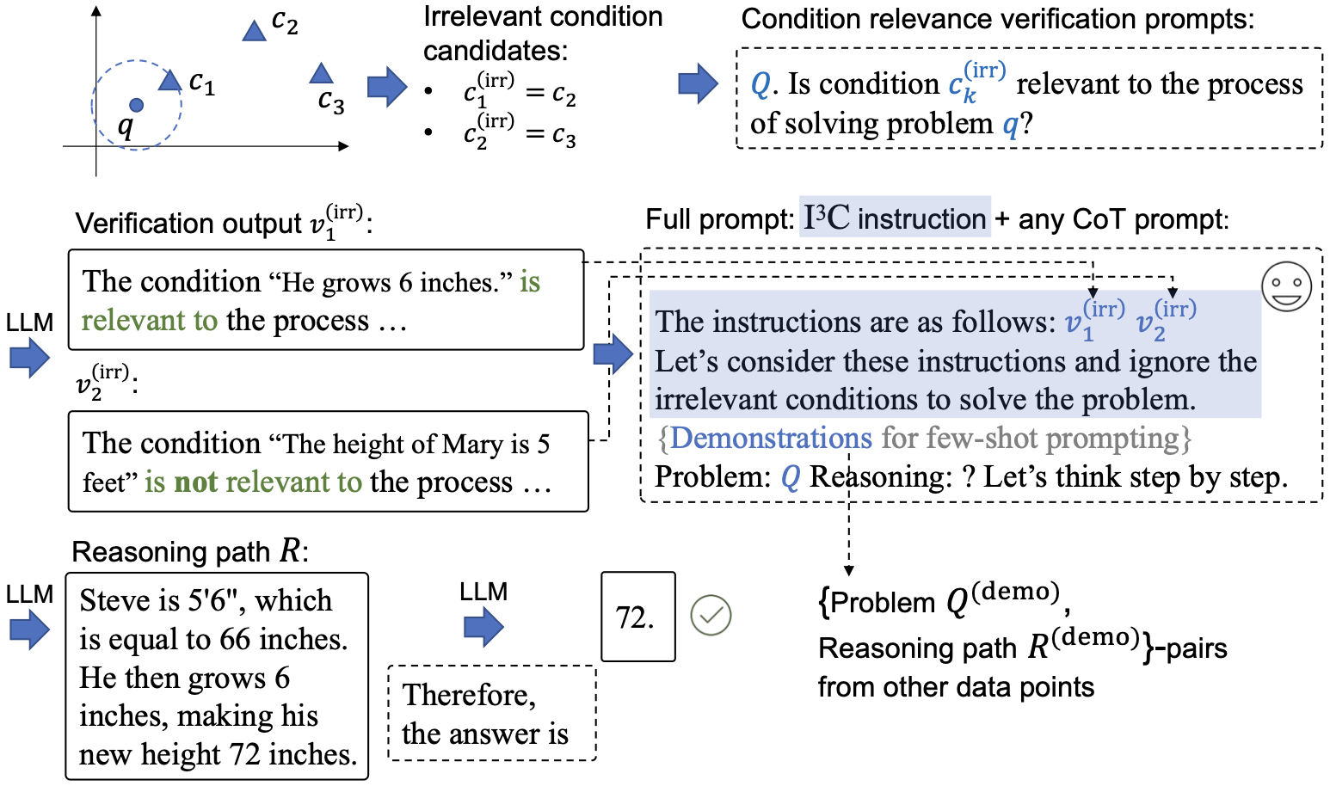
Wu et al. Instructing Large Language Models to Identify and Ignore Irrelevant Conditions (NAACL 2024).

Slide 15
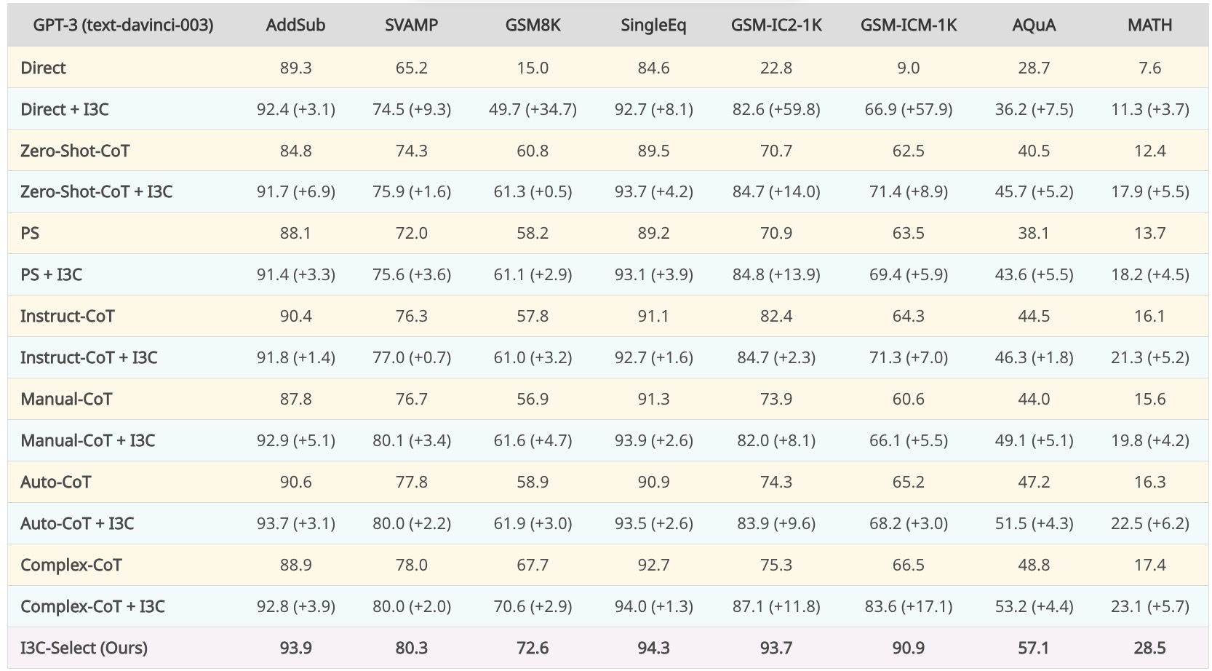
few-shot I3C

Slide 16
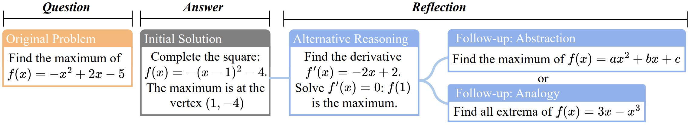
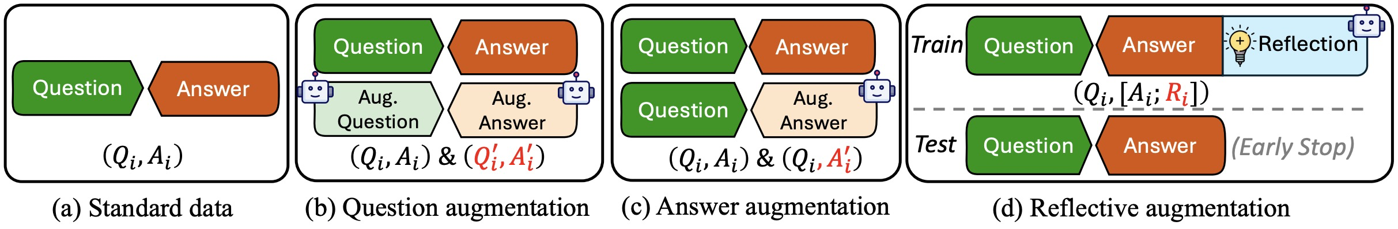
Enhancing Reasoning with Reflection
Zhang et al. Learn Beyond The Answer: Training Language Models with Reflection for Math Reasoning.

Slide 17
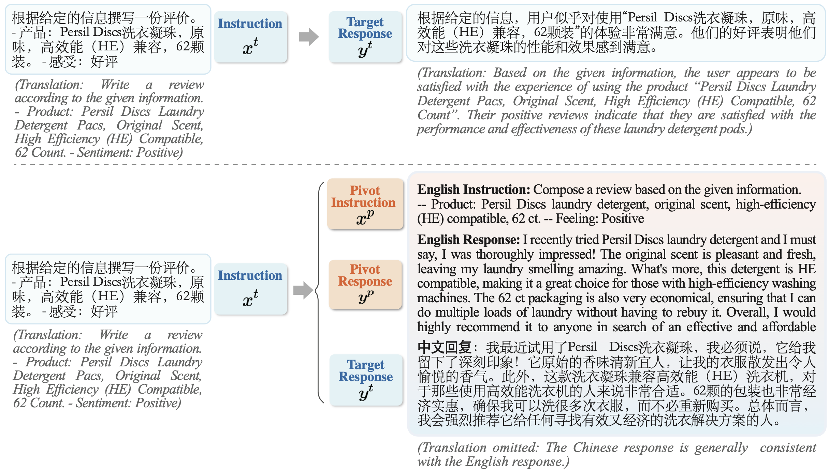
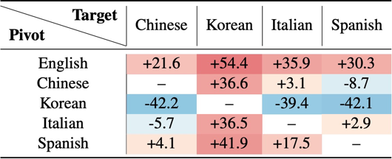
Zhang et al. PLUG: Leveraging Pivot Language in Cross-Lingual Instruction Tuning.

Slide 18
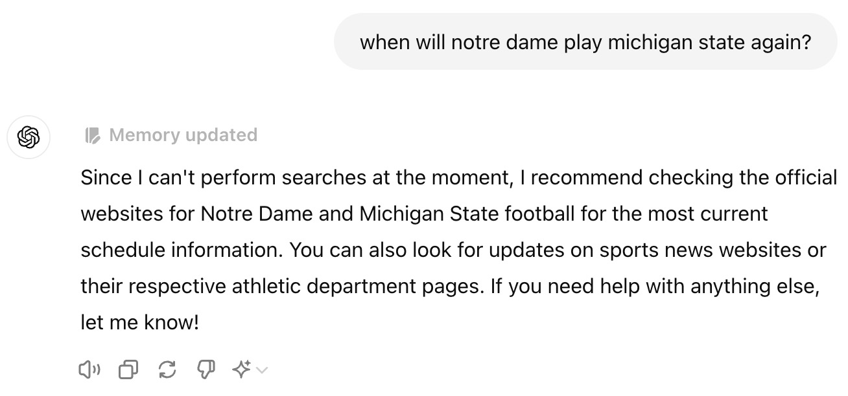
Closed-Book
Large Language Model (LLM)
Pre-collected corpus
Pre-training
175 Billion parameters
(or bigger)
(self-supervision)
Human feedback
R. L.
Input (e.g. question)
Output
tasks
when will notre dame play michigan state again?

Slide 19

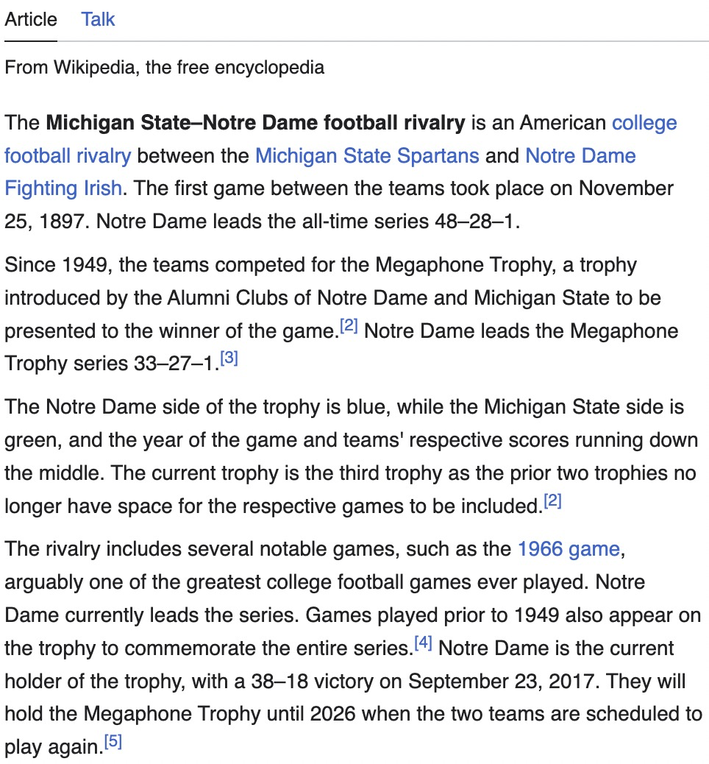
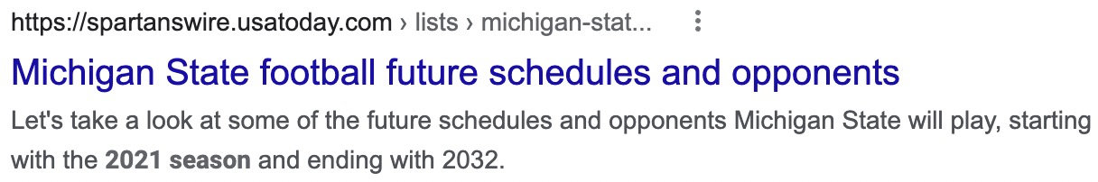
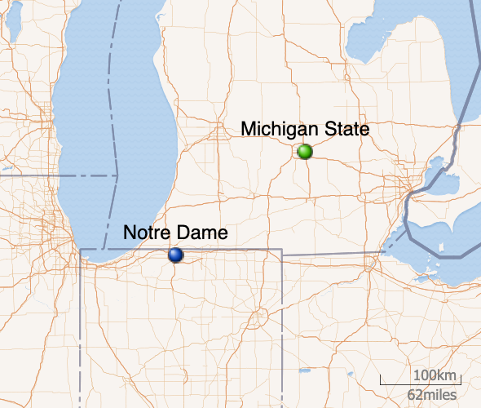


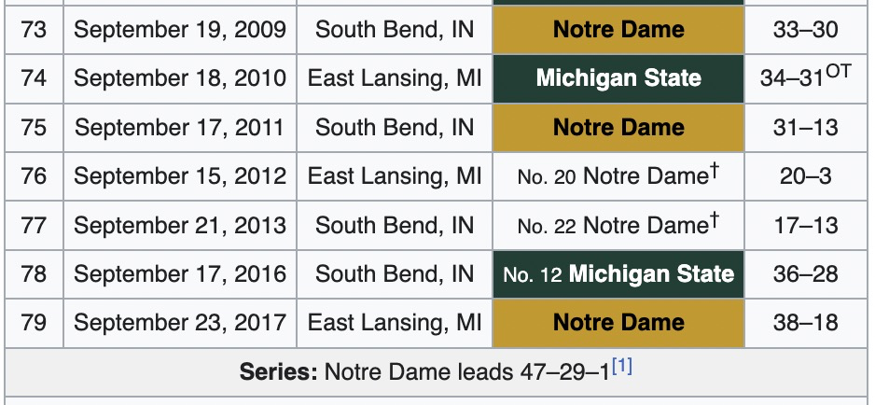
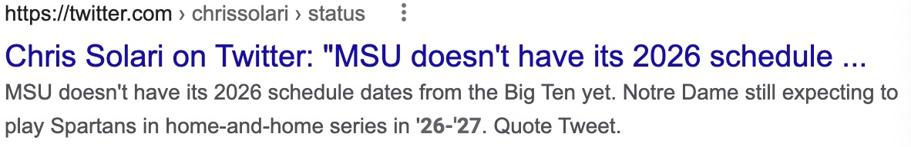
How do humans find the answer?
read
Wikipedia
search

Slide 20
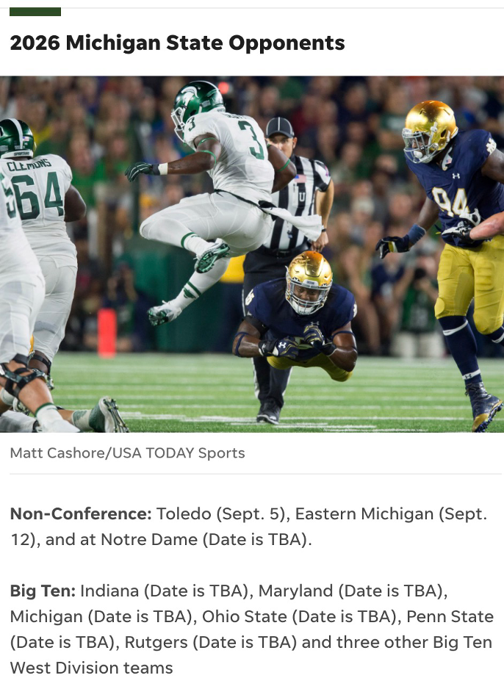
How do humans find the answer?
Wikipedia
News (August 20, 2021)
read
search

Slide 21
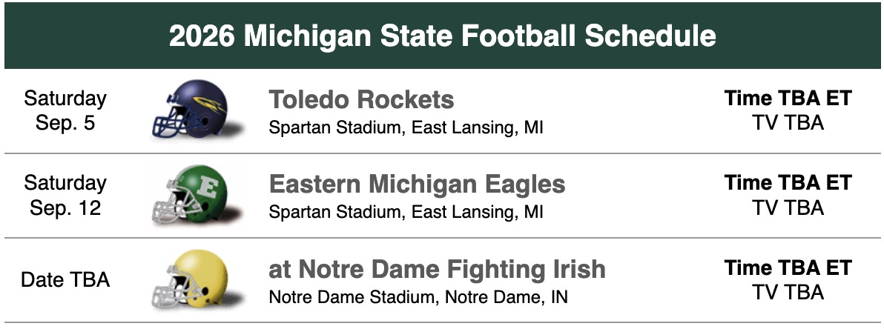
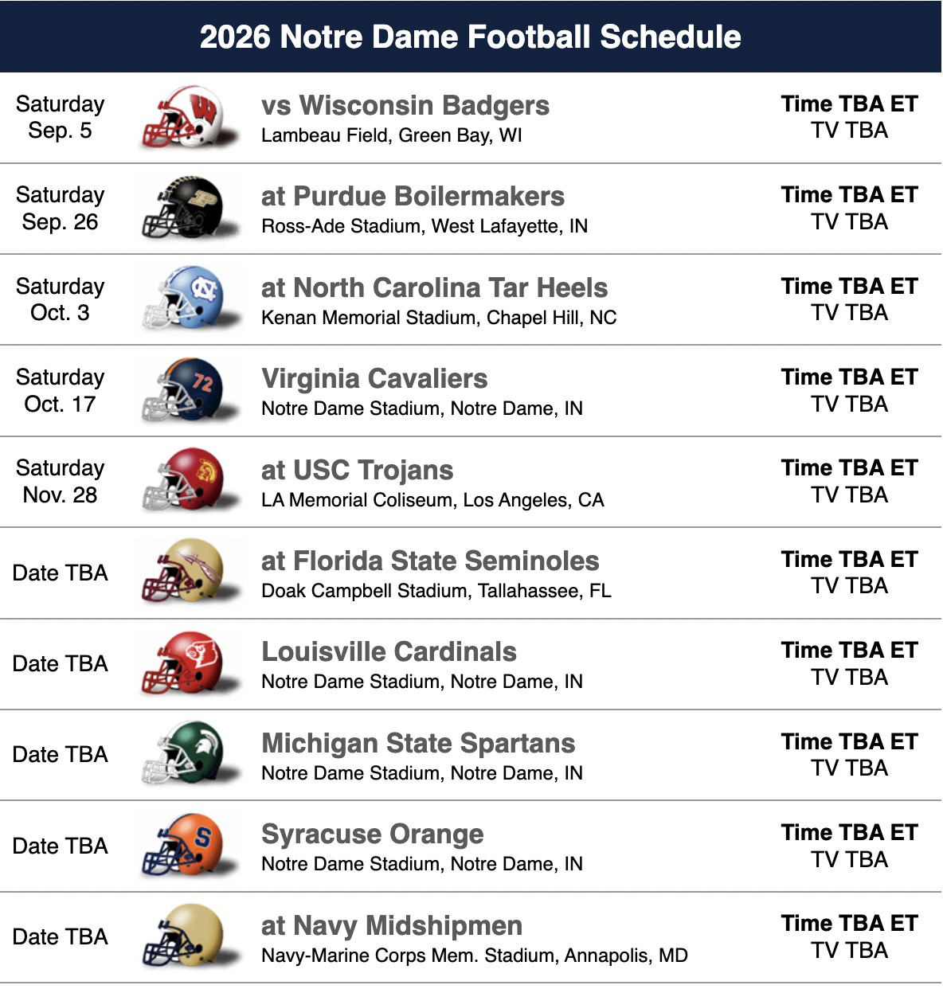
How do humans find the answer?
Wikipedia
News (August 20, 2021)
search
Database
read

Slide 22
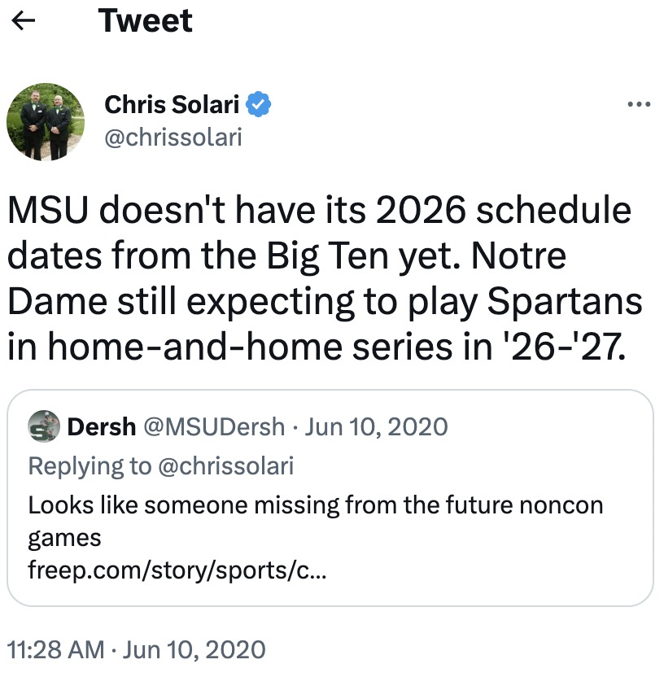
How do humans find the answer?
Wikipedia
News (August 20, 2021)
search
Database
Social media (June 10, 2020)

Slide 23
Closed-Book
Open-Book
Large Language Model (LLM)
Knowledge Augmentation
Pre-collected corpus
Pre-training
175 Billion parameters
(or bigger)
External
knowledge
sources
Wikipedia
News
Database
Social media
…
(self-supervision)
Human feedback
R. L.
Retriever
(~0.12B)
Input (e.g. question)
Output
Input
Knowledge
(e.g., passage)
Output
tasks
tasks
Lack of recent / specialized knowledge
Lack of fine-tuning flexibility
Lack of evidence traceability / reliability
Reader/Generator
(< 0.25B parameters)

Slide 24
Multi-choice Commonsense Question Answering
Commonsense Fact Verification
(Accuracy) | CSQA1.0 | OBQA
RACo | 75.76 | 71.25
GreaseLM | 74.20 | 66.90
QA-GNN | 73.40 | 67.80
UNICORN | 71.60 | 70.02
T5-Large | 70.14 | 66.02
KAGNet | 69.00 | -
(Accuracy) | CSQA2.0 | CREAK
RACo | 61.75 | 84.17
UNICORN | 54.90 | 79.51
GreaseLM | - | 77.51
T5-Large | 54.60 | 77.32
🏆
🏆
Constrained Commonsense Generation
Counterfactual Explanation Generation
CommonGen | (BL-4) | (SPICE)
RACo | 42.76 | 33.89
KFCNet | 41.97 | 33.11
UNICORN | 39.86 | 33.20
KG-BART | 30.90 | 32.70
CALM | 29.50 | 30.20
T5-Large | 28.60 | 31.60
ComVE | (BL-4) | (SPICE)
RACo | 25.30 | 36.37
UNICORN | 24.46 | 35.79
CALM | 23.50 | 35.23
MoKGE | 22.87 | 34.88
T5-Large | 22.77 | 34.62
GraphRF | 22.07 | 33.09
🏆
🏆

Slide 25
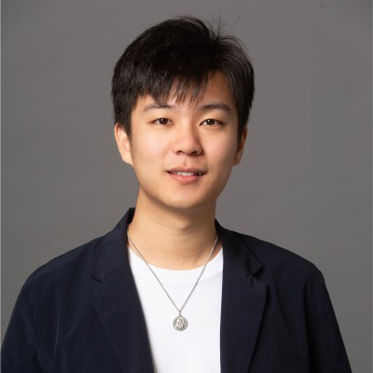
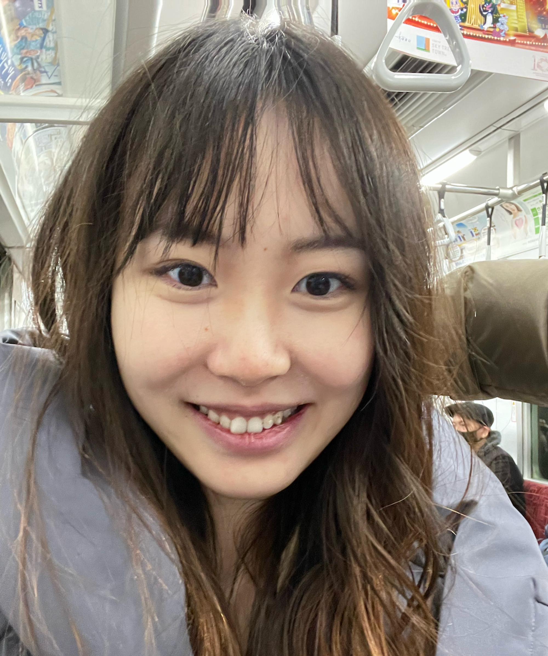
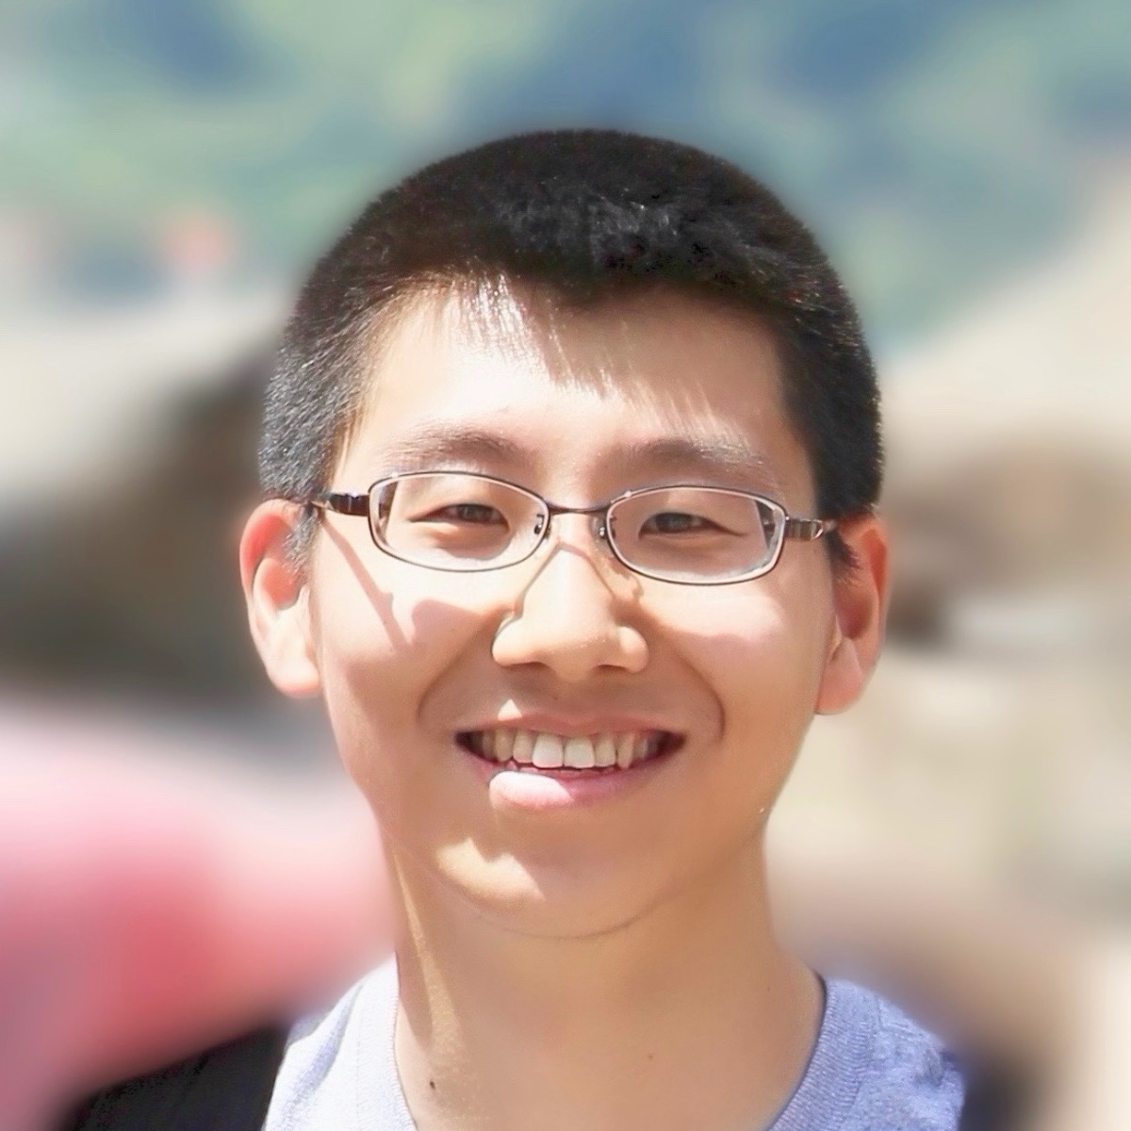
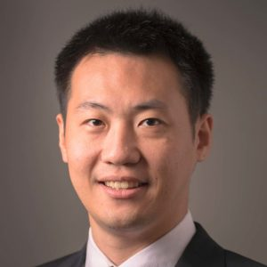
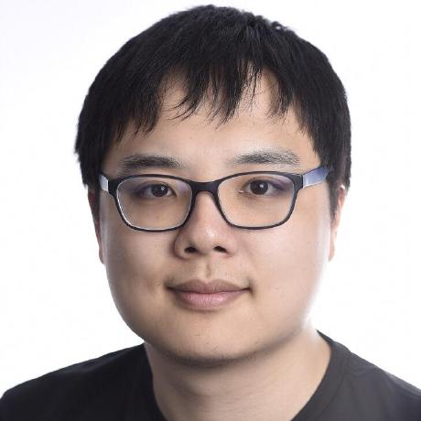
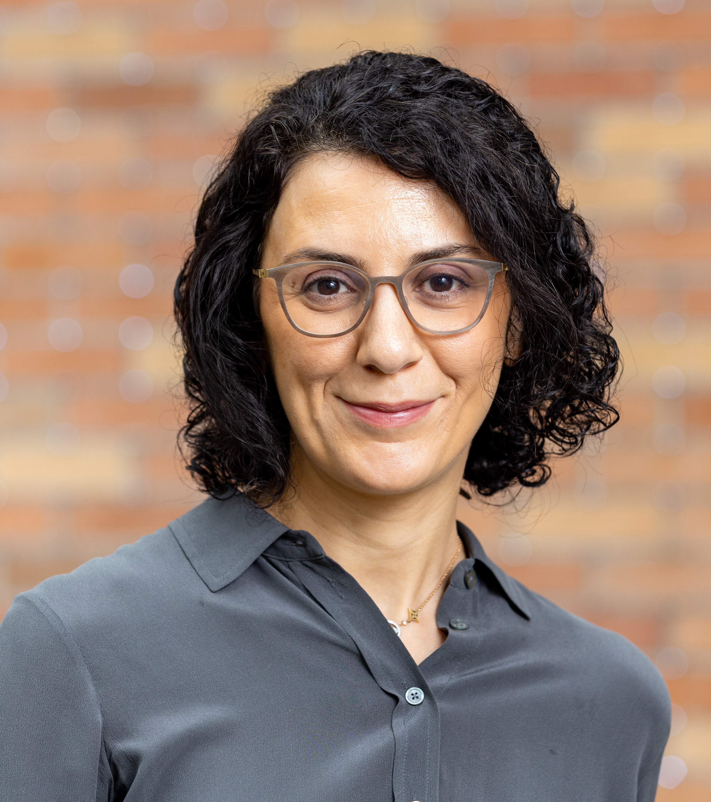
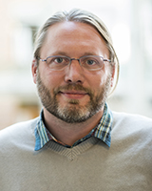
Knowledge-Augmented NLP
“Open-Book” and Knowledge Heterogeneity
External
knowledge
sources
Survey paper:
A Survey of Knowledge-Enhanced Text Generation. ACM Computing Surveys, 2022.
Tutorials:
Knowledge-Enriched Natural Language Generation. EMNLP 2021.
Knowledge-Augmented Methods for NLP. ACL 2022.
Knowledge-Augmented Methods for NLP. WSDM 2023.
Workshops:
KnowledgeNLP-AAAI 2023. https://knowledge-nlp.github.io/aaai2023/
KnowledgeNLP-KDD 2023. https://knowledge-nlp.github.io/kdd2023/
KnowledgeNLP-ACL 2024. https://knowledge-nlp.github.io/acl2024/ (August 11-16 in Bangkok, Thailand)
Wikipedia
News
Database
Social media
…
Retriever
Input
Knowledge
(e.g., passages)
Output
tasks
Reader, Generator, or Large Language Model

Slide 26
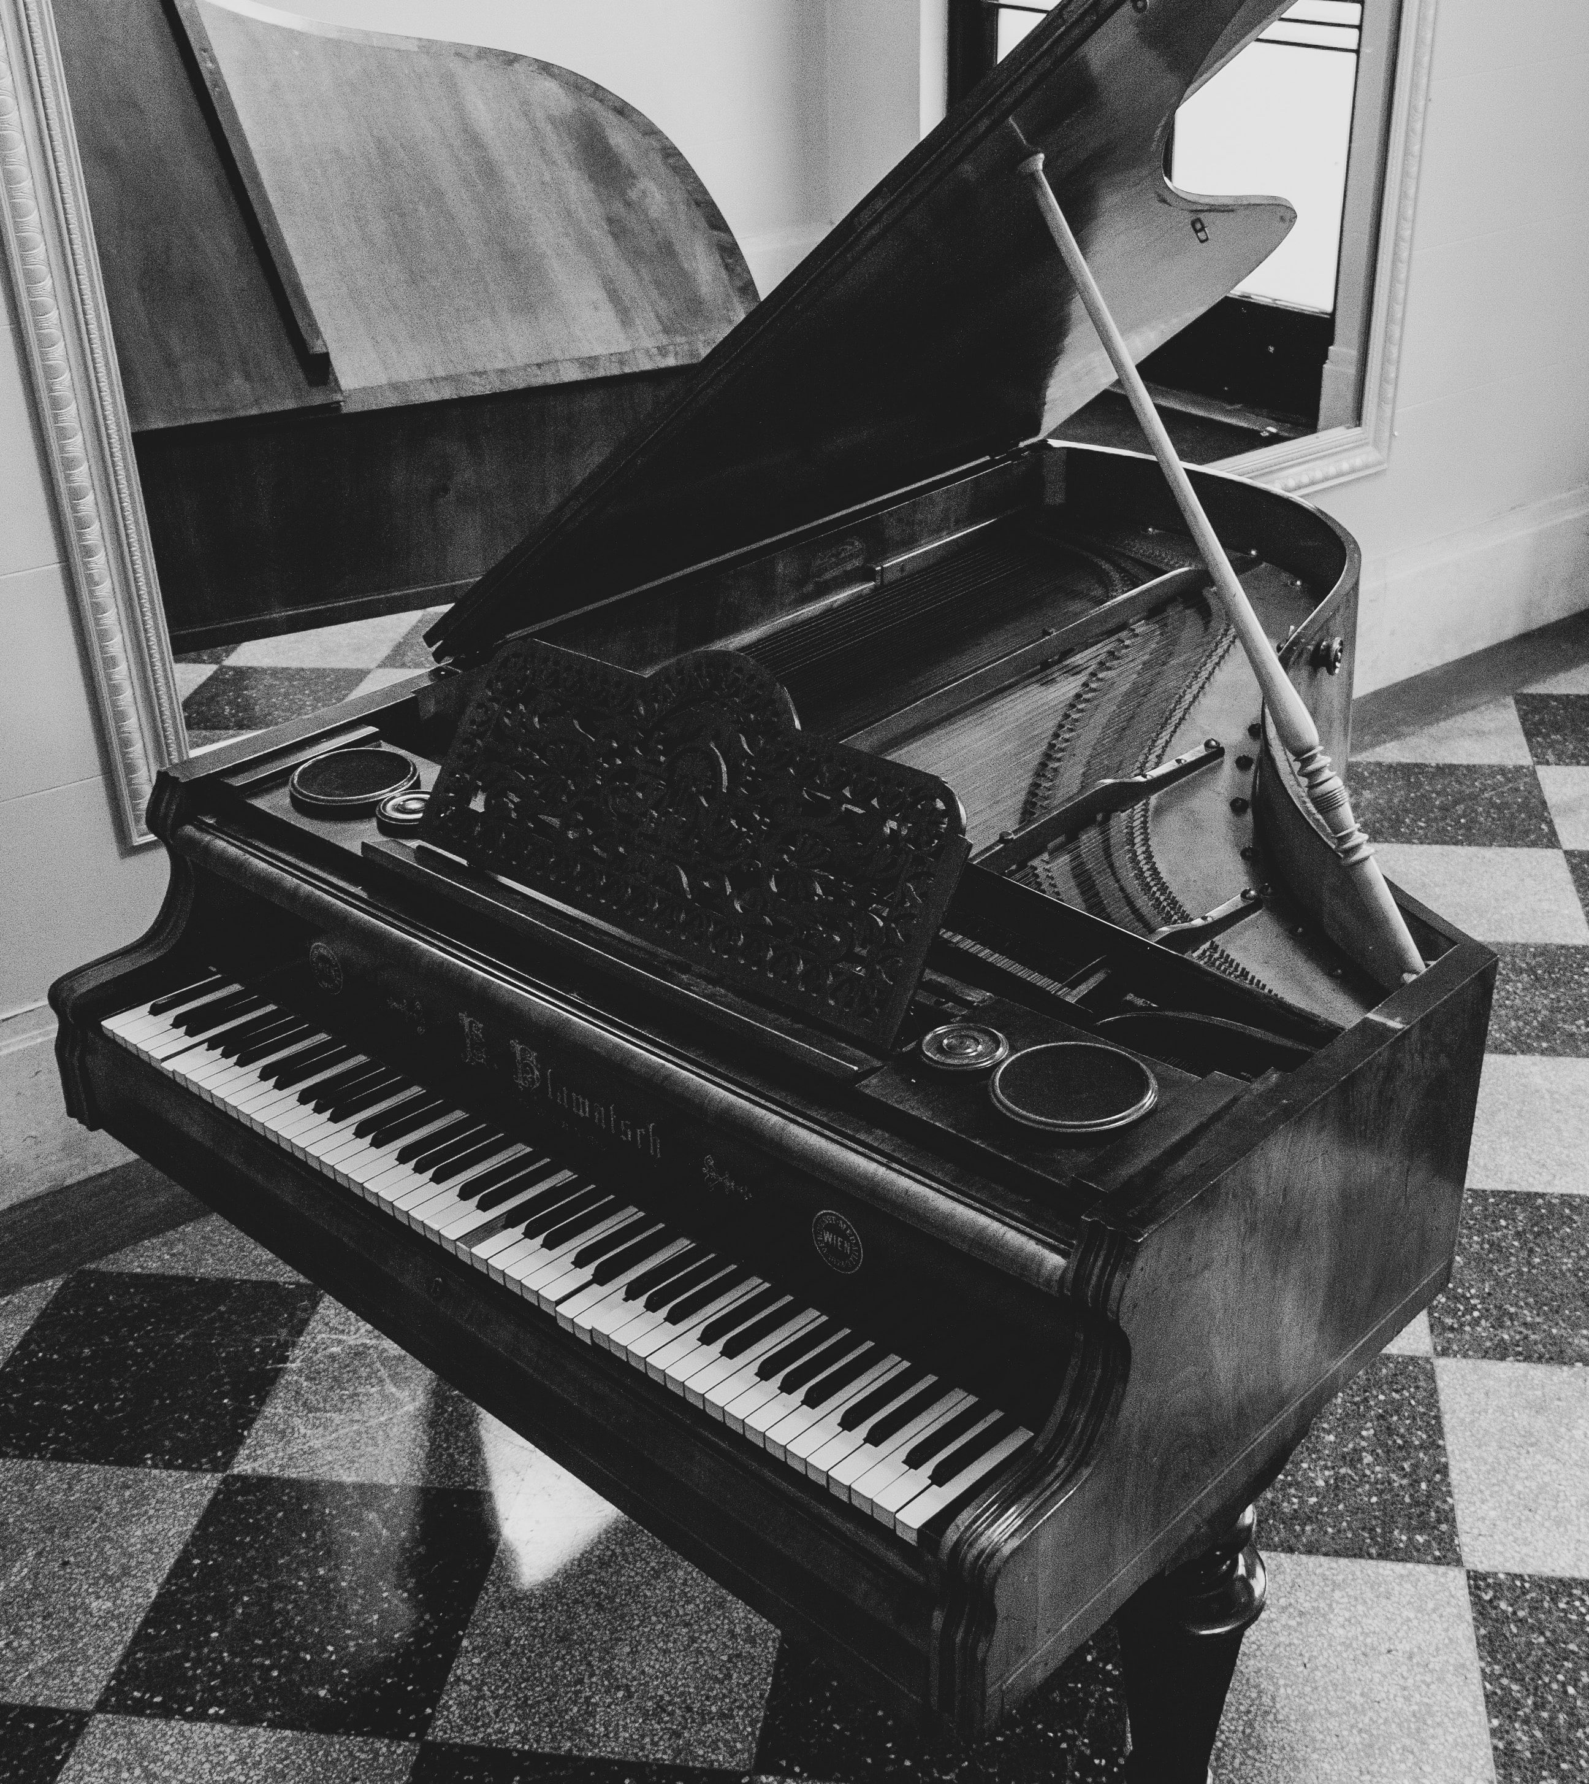
How about Answer Diversity?
Explaining counterfactual statements
Input:
Piano is a kind of sport. This is False because ___________________
Annotators 1 and 4:
you can produce music when pressing keys on the piano, so it is an instrument.
Annotators 3 and 5:
piano is a musical instrument used in songs to produce different musical tones.
Annotator 2:
piano is a kind of art form.

Slide 27
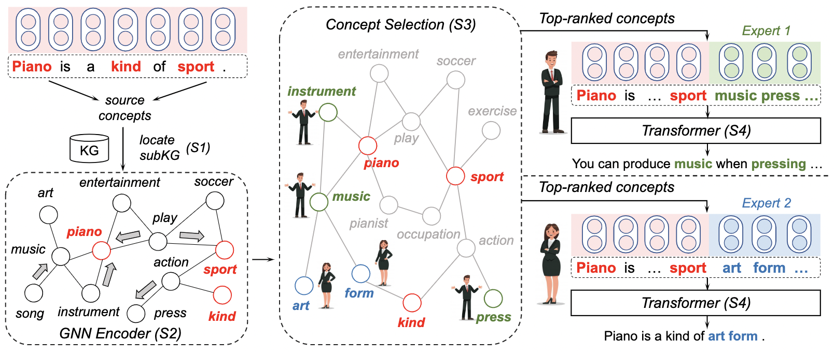
Generating Diverse Explanations
Mixture of Knowledge Graph Experts (MoKGE)
Yu et al. Diversifying Content Generation for Commonsense Reasoning with Mixture of Knowledge Graph Experts (ACL’22)

Slide 28
Take Away
Scaling Law enables in-context learning that instructs LLMs to reason.
Prompting: Implement verification and reflection for math reasoning.
Retrieval-augmented generation: Create an open-book environment.
and many other ideas: Ignore irrelevant conditions, Leverage pivot language, Outline diverse answers, etc.

Slide 29

Welcome to visit our lab!
http://www.meng-jiang.com/lab.html
https://github.com/DM2-ND
mjiang2@nd.edu
28

Slide 30
Multi-choice Commonsense Question Answering
Commonsense Fact Verification
Where can I stand on a river to see water falling without getting wet?
A pound of cotton has the same weight as a pound of steel.
A) waterfall
B) bridge
C) valley
D) stream
E) bottom
True
False
Datasets:
OpenBookQA: Clark et al. arxiv 2018. (5,957 questions)
CommonsenseQA 1.0： Talmor et al. NAACL 2019. (12,102)
Evaluation: Accuracy.
Datasets:
CommonsenseQA 2.0: Talmor et al. (14,343 assertions)
CREAK： Onoe et al. NeurIPS 2021 Benchmark Track. (13,000)
Evaluation: Accuracy.
Constrained Commonsense Generation
Counterfactual Explanation Generation
Constraints: dog, frisbee, catch, throw
I am hungry for water.
Description: A girl throws a frisbee and her dog catches it.
Outputs:
1) Water is used to quench thirsty.
2) You are thirsty for water, not hungry.
3) Water is not food.
Datasets:
CommonGen: Lin et al. Findings of EMNLP 2020. (79,000+ commonsense descriptions)
Evaluation: SPICE, BLEU-4, ROUGE-L, CIDEr.
Datasets:
ComVE: Wang et al. SemEval-2020 Task 4 (11,997 examples)
Evaluation: SPICE, BLEU-4, ROUGE-L, CIDEr.

Slide 31
Commonsense Benchmark Datasets
Where can I stand on a river to see water falling without getting wet?
αNLI
COSMOSQA
HELLA
SWAG
A) waterfall
B) bridge
C) valley
D) stream
E) bottom
PIQA
SOCIAL
IQA
…
A pound of cotton has the same weight as a pound of steel.
Human Annotated Facts
(e.g., Relations, Knowledge Graphs)
True
False
Constraints: dog, frisbee, catch, throw
OMCS
ATOMIC
Wiktionary
Description: A girl throws a frisbee and her dog catches it.
…
I am hungry for water.
Commonsense Relevant Corpus
(e.g., Statements, Knowledge Bases)
Outputs:
1) Water is used to quench thirsty.
2) You are thirsty for water, not hungry.
3) Water is not food.
ARC
QASC
GenericsKB
…

Slide 32
Dense Passage Retriever
Large-Scale
Commonsense
Corpus
Commonsense Benchmark Datasets
Source Heterogeneity
(e.g., transform KG / KB)
Human Annotated Facts
(e.g., Relations, Knowledge Graphs)
Commonsense Relevant Corpus
(e.g., Statements, Knowledge Bases)
Input
Retrieved Passages
Output
Multi-choice Commonsense Question Answering
Commonsense Fact Verification
Constrained Commonsense Generation
Generator
(as classifier if needed)
Counterfactual Explanation Generation
Constraints: dog, frisbee, catch, throw
Description: A girl throws a frisbee and her dog catches it.
Yu et al. Retrieval Augmentation for Commonsense Reasoning: A Unified Approach (EMNLP’22)

Slide 33
Open-Domain Question Answering
LLMs in Open-Book Framework
Wikipedia
GPT-3
Retriever
Retrieved passages
Generated passages
Question
Answer
Question
Answer
Reader
Reader

Slide 34

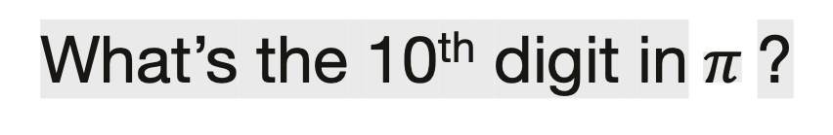
Who got the first Nobel prize in physics?
Who got the first Nobel prize in physics?
“Generate a background document to answer
the given question [Q]:”
“Question: [Q] Answer:”
The first Nobel Prize in Physics was awarded in 1901 to Wilhelm Conrad Rontgen in recognition of the extraordinary services he has rendered by the discovery of the remarkable rays subsequently named after him
GPT-3
(175 Billion parameters)
GPT-3
“Question: [Q]
Passage: [P]
Answer: ”
GPT-3
Albert Einstein.
Wilhelm Conrad Rontgen
What’s the 10th digit in$π$?
Yu et al. Generate rather than Retrieve: Large Language Models are Strong Context Generators (ICLR’23)

Slide 35
Why not use GPT-3 to directly generate the answer?
Who got the first Nobel prize in physics?
Who got the first Nobel prize in physics?
“Generate a background document to answer
the given question [Q]:”
“Question: [Q] Answer:”
Zero-Shot Open-Domain Question Answering
The first Nobel Prize in Physics was awarded in 1901 to Wilhelm Conrad Rontgen in recognition of the extraordinary services he has rendered by the discovery of the remarkable rays subsequently named after him
GPT-3
(175 Billion parameters)
GPT-3
(Exact Match) | Web Questions | Natural Questions | TriviaQA
Ours | 24.8 | 28.2 | 59.3
PaLM (540B) | 19.0 | 24.7 | 56.7
InstructGPT | 18.6 | 20.9 | 52.6
🏆
“Question: [Q]
Passage: [P]
Answer: ”
GPT-3
Albert Einstein.
Wilhelm Conrad Rontgen
GPT-3 is not a reader specialist. Fusion-in-Decoder (FiD) is the state-of-the-art Reader. Supervised Learning (with FiD) performs much better than Zero-Shot.
Izacard and Grave. Leveraging Passage Retrieval with Generative Models for Open Domain Question Answering. EACL 2021.

Slide 36
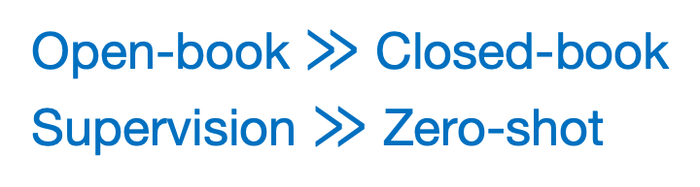
GenRead: Supervised Learning
“Many shots”: Training QA specialists
WebQ | NaturalQ | TriviaQA
56.2 | 54.0 | 74.3
55.4 | - | 72.6
54.5 | 45.6 | 71.6
50.8 | 50.1 | 66.3
53.6 | 45.0 | 65.4
46.5 | 42.8 | 65.4
24.8 28.2 | 28.2 37.5 | 59.3 86.1
Merged | Reader
GPT-3 + DPR | FiD
🏆
Passages complementarity
Ours:
Generator | Reader
Codex | FiD
GPT-3 | FiD
Ours:
LLMs are effective for
knowledge augmentation
Ours:
Retriever | Reader
DPR | FiD
Google API | FiD
BM25 | FiD
State-of-the-art:
Open-book $≫$ Closed-book
Supervision $≫$ Zero-shot
Generator (closed-book)
GPT-3 (zero-shot) PALM 2-L (one-shot)
(released 5/10/2023)

Slide 37
Surprising Zero-Shot / Few-Shot Performance
Large Language Models are Built-in Auto-regressive Search Engines (ACL-Findings 2023)
GPT-3
GPT-3
Generated URLs
Wikipedia
Passages
90% contain answer
w/o indexing docs
Generated passages
Input
Output
Input
Output
“Question: [Q]. Which [k] URLs would have the answer?”
GPT-3
GPT-3
GenRead
LLM-URL
(Exact Match) | Web Questions | Natural Questions | TriviaQA
LLM-URL (few-shot) | 29.0 | 27.3 | 60.7
LLM-URL (zero-shot) | 28.1 | 26.4 | 60.1
GenRead (zero-shot) | 24.8 | 28.2 | 59.3
PaLM (540B) | 19.0 | 24.7 | 56.7
InstructGPT | 18.6 | 20.9 | 52.6

